Slide 1
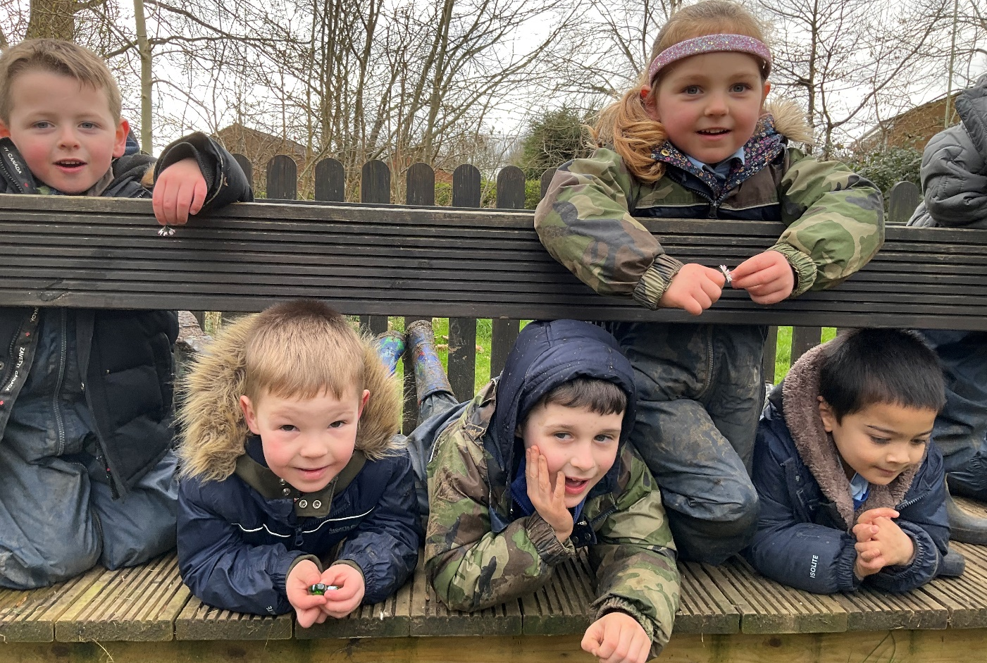
Holtsmere End Infant and Nursery School
Forest School
Impact
2023-24
Notes:
NOTE: To change images on this slide, select a picture and delete it. Then click the Insert Picture icon
in the placeholder to insert your own image.

Slide 2
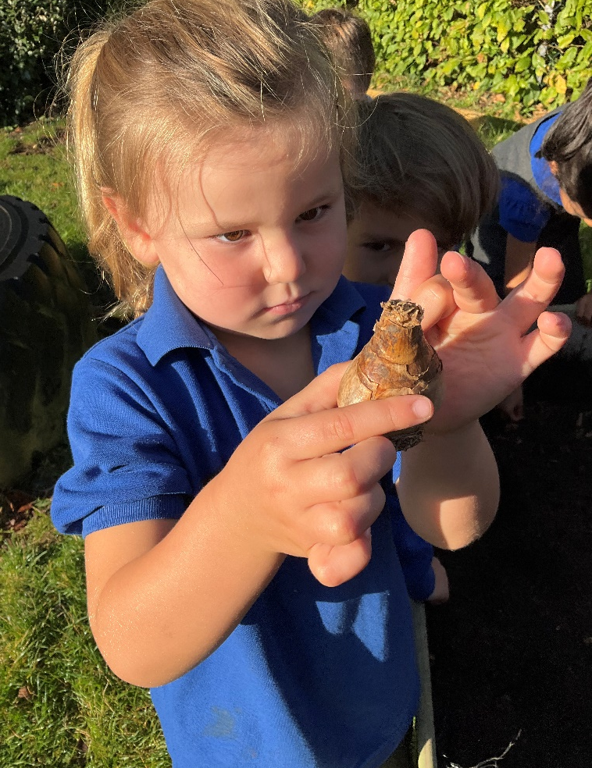
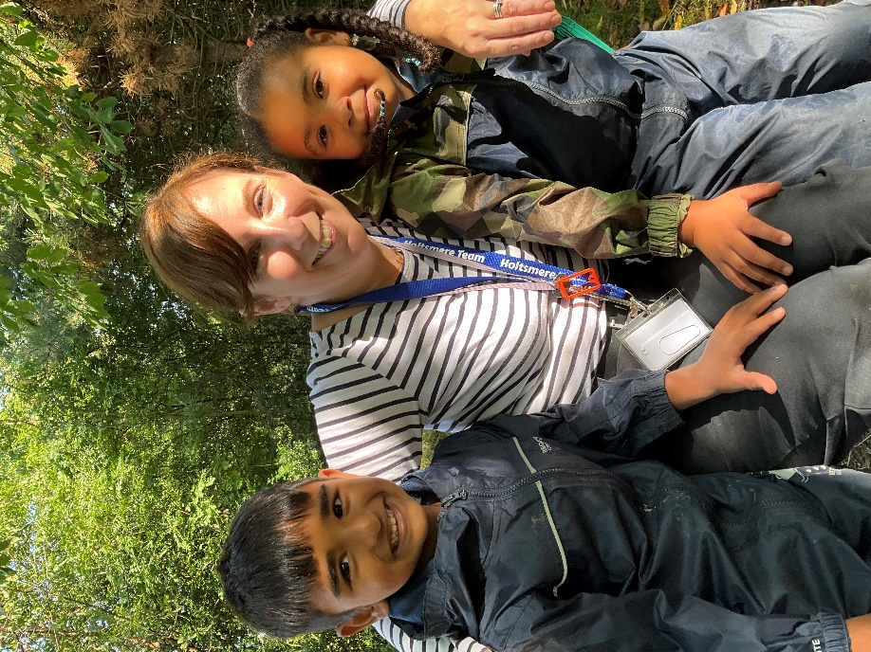
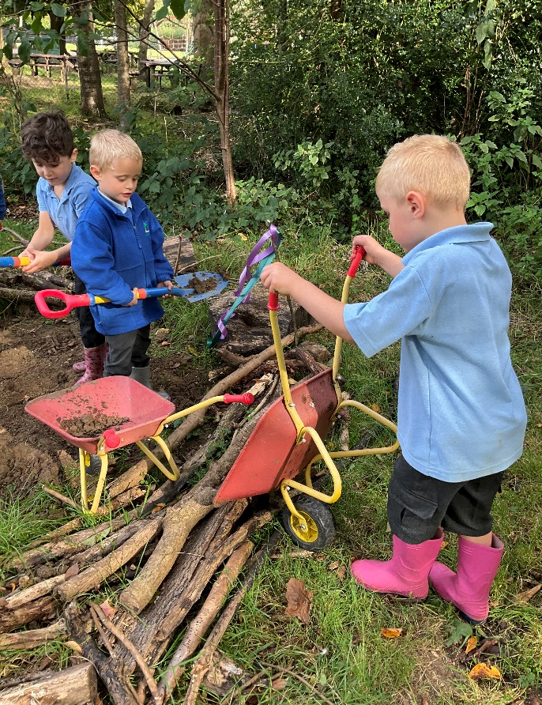
Forest School 23-24
Notes:
NOTE: To change images on this slide, select a picture and delete it. Then click the Insert Picture icon
in the placeholder to insert your own image.

Slide 3
We observe a selection of children at the beginning of their Forest School adventure and at the end of the year to measure the impact of the sessions on their:
Self awareness
Self- regulation
Self- motivation
Social skills
Empathy

Slide 4
Child C - Reception
December 2023
Score 1-5
Self awareness - 3
Self- regulation - 2
Self- motivation - 3
Social skills - 3
Empathy – 3
Child B – Nursery
December 2023
Score 1-5
Self awareness - 1
Self- regulation - 1
Self- motivation - 1
Social skills - 1
Empathy – 1
Child A- Reception
June 2024
Score 1-5
Self awareness –4
Empathy - 3
Self regulation – 4
Self motivation - 4
Social skills- 4
Empathy - 4
Child B- Nursery
June 2024
Score 1-5
Self awareness –3
Empathy - 3
Self regulation – 4
Self motivation – 4
Social skills – 4
Empathy - 3
*** has come on leaps and bounds. We have a very good relationship. He has built on his engagement, self-help and motivation.
***** has made remarkable progress. Great relationships. Engaged, happy, interested – adds value in conversation. Brave and resilient.

Slide 5
Child C - Reception
December 2023
Score 1-5
Self awareness - 3
Self- regulation - 3
Self- motivation - 3
Social skills - 3
Empathy – 3
Child D – Nursery
December 2023
Score 1-5
Self awareness - 1
Self- regulation - 1
Self- motivation - 1
Social skills - 2
Empathy – 1
Child A- Reception
July 2024
Score 1-5
Self awareness –5
Self regulation – 4
Self motivation - 5
Social skills- 5
Empathy - 5
Child D- Nursery
June 2024
Score 1-5
Self awareness –1
Empathy - 1
Self regulation – 2
Self motivation – 2
Social skills – 3
Empathy - 2
*** is fantastic in Forest School. She can be a leader of ideas. She can work in a team. She has huge empathy. She listens, engages and joins in. She has built on her resilience and bravery.
*****wants to come to the session. Knows the routine, is happy and engaged. Loves to be outside. Loves bugs etc. Needs to work on vocabulary and emotional regulation.

Slide 6
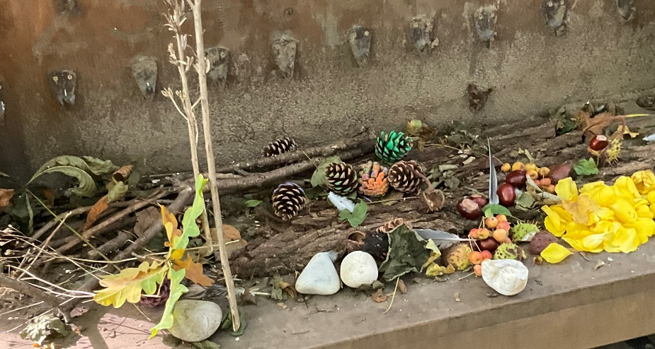
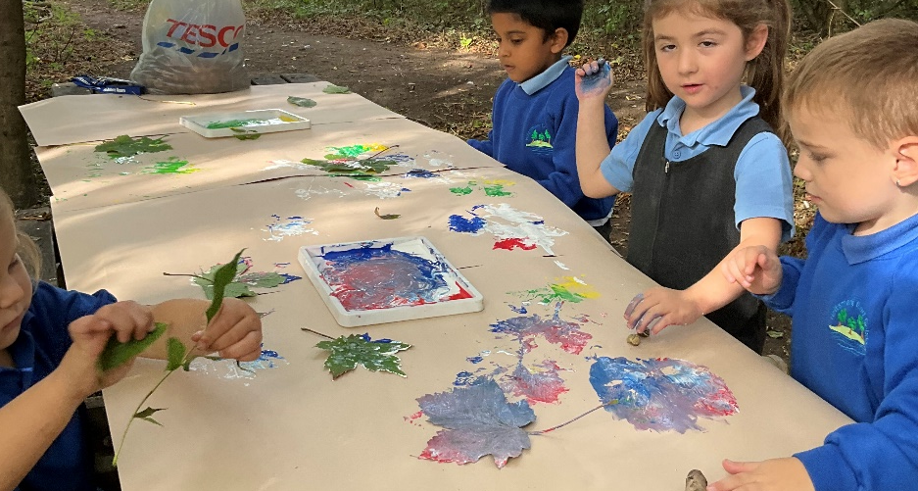
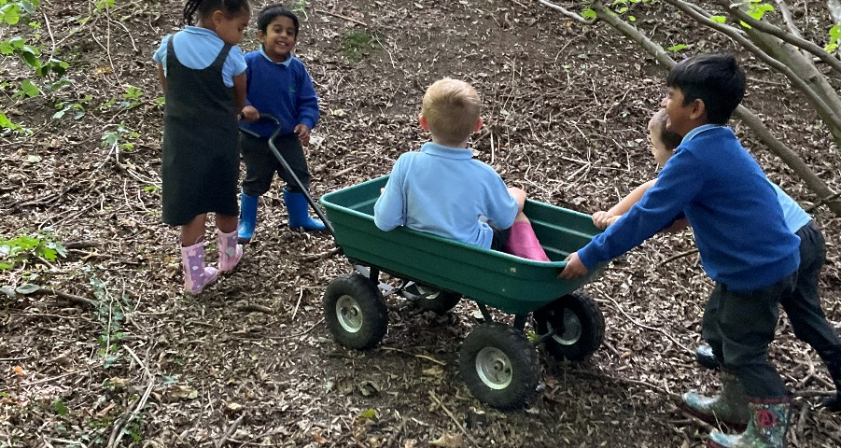
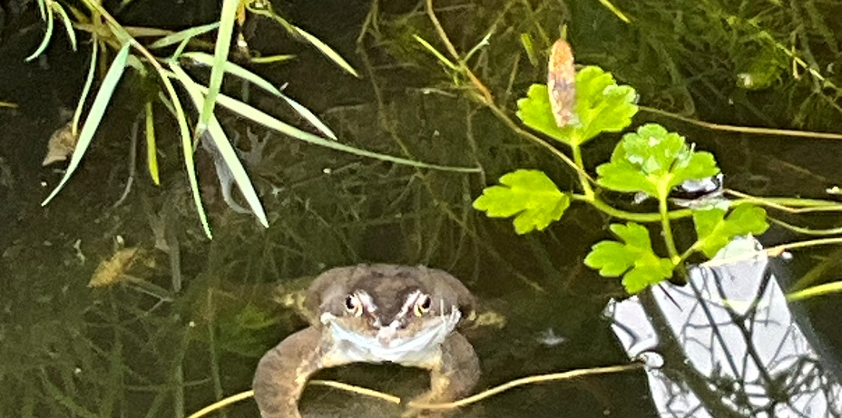
Forest School

Slide 7
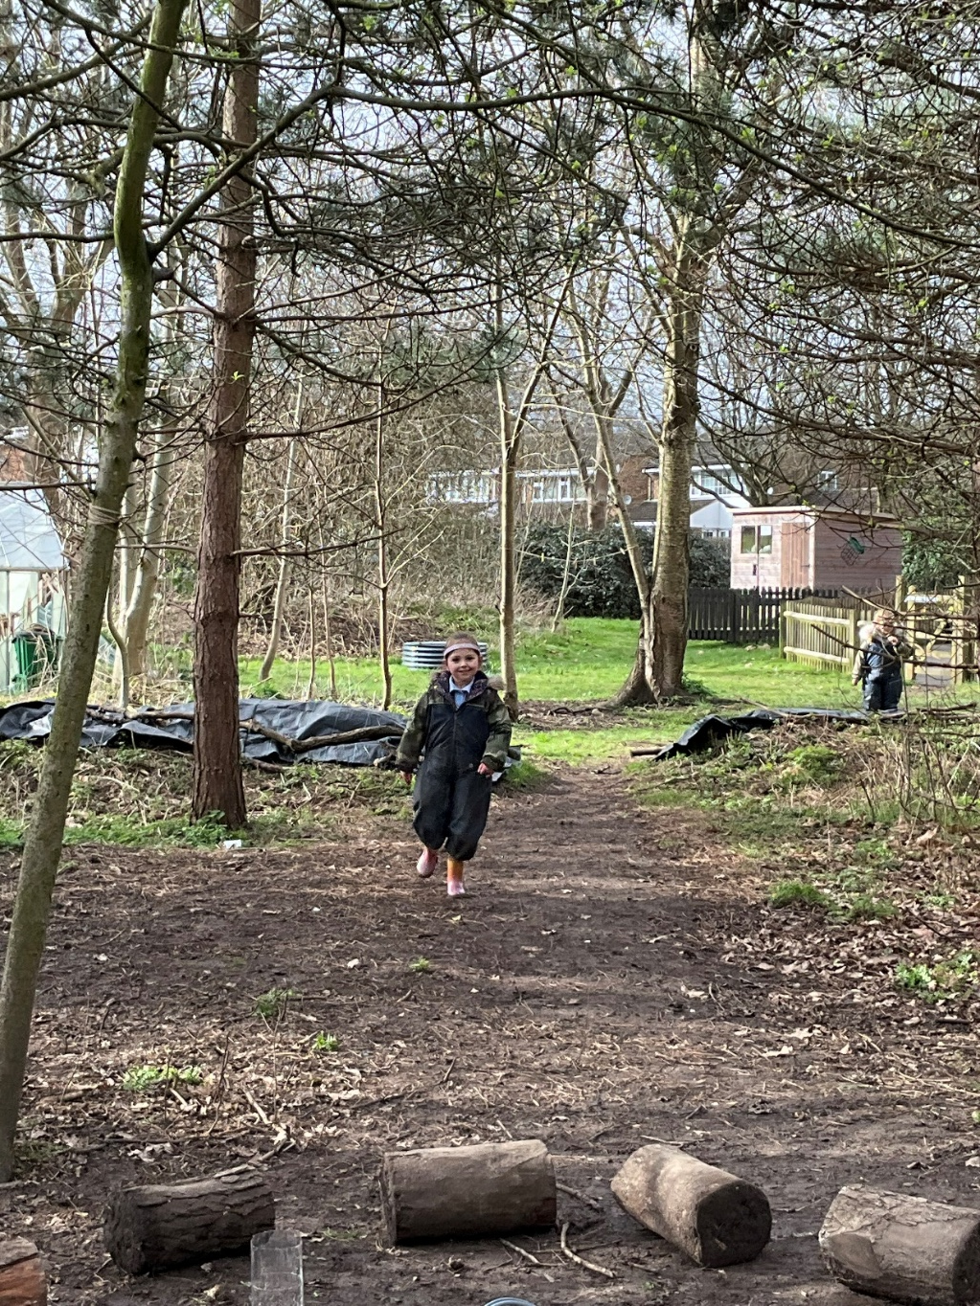
‘Forest school makes me happy because it is so fun, We get hot chocolate and we catch frogs and put them back in the pond.’
‘I like going on a bear hunt. I can see the mushrooms. I like the ice cream on a sunny day. I like the slide, the climbing tree and catching frogs.’
‘I like the digging area. I found slugs and frogs. Forest school makes me happy.’
‘I like the pond in Forest School because I find frogs and tadpoles.’

Slide 8
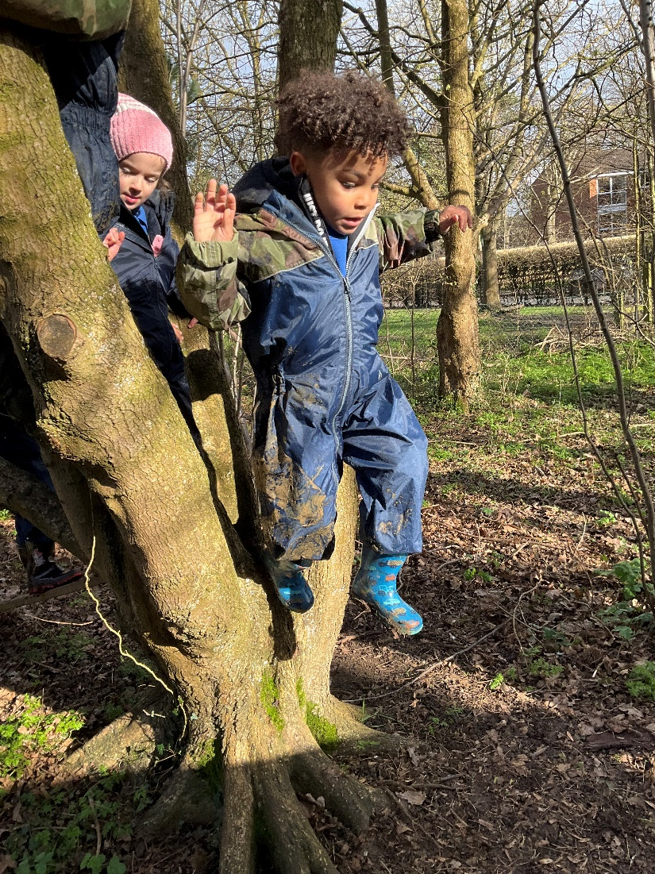
Forest School
‘I find flowers in Forest School and make potions.’
‘I like the potions area. I put flowers in and seeds and I mix the colours. Red and blue make purple.’
‘I jump in the muddy puddles and pick up all the snails.’
‘I like going on adventures with my friends.’
‘I love to go in the tent and read the books with my friends.’
‘I like tug of war. You can pull the rope to see who is the strongest.’

Slide 9
‘Forest school makes me happy because I can hide in the green leaves and swing.’

